Slide 1
The Personal Statement
Your opportunity to tell uni’s why they should choose you

Slide 2
The Basics
2020 – 559,030 applicants to UCAS
2021 – 561,420 applicants to UCAS
Many uni’s/courses ‘weight’ applicants by PS
ENSURE YOU STAND OUT FROM THE CROWD!!!
4000 characters/47 lines (approx. 600 words) to demonstrate suitability and show enthusiasm and commitment

Slide 3
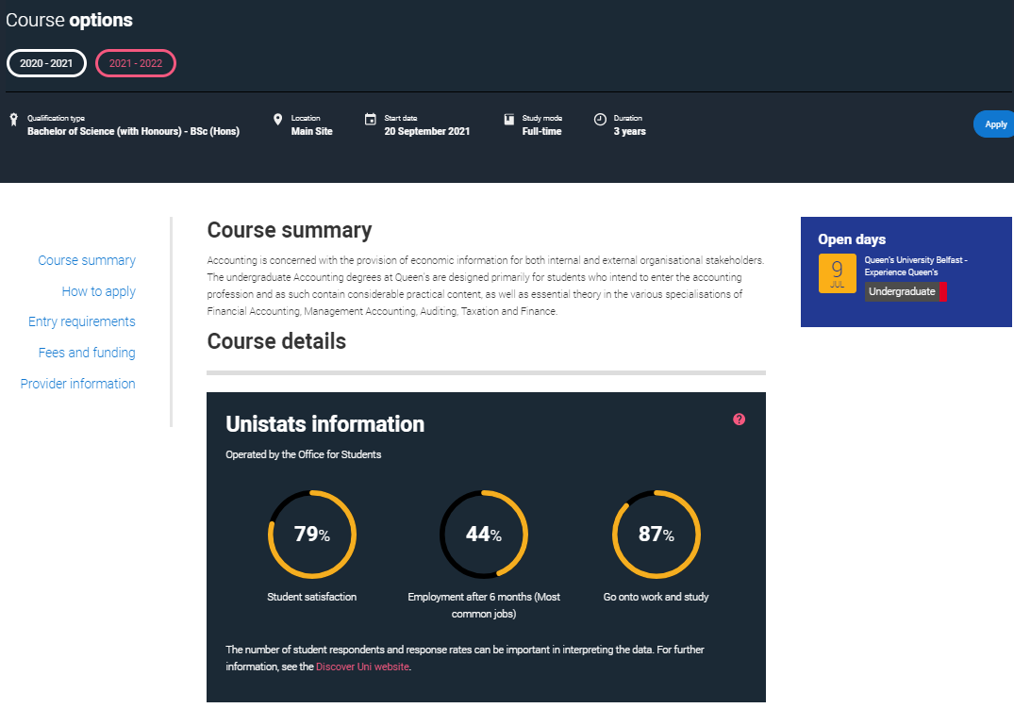
Before Writing your PS
Refer to UCAS and university site…

Slide 4
Planning Your PS
Key Questions:
Why are you applying?
What makes you suitable?
Which of your skills and experiences are most relevant?
Do a mind map
Complete the UCAS ‘scaffolding’ document
Draft should be double-line spacing

Slide 5
Complete these sections:
e.g.
Why applying?
Why interested?
Why a good student?
etc
etc

Slide 6
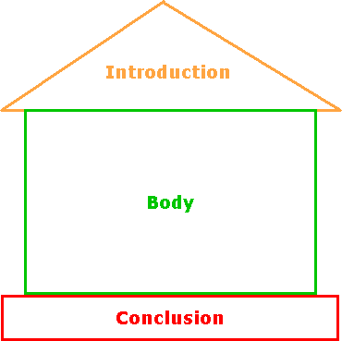
Structure
You are applying to a highly academic course… your personal statement should be roughly 2/3 academic and 1/3 everything else.
P1 – Introduction/Motivation
P2 – 1st A-Level
P3 – 2nd A-Level
P4 – 3rd A-Level
P5 – 4th A-Level??
P6 – Work Experience
P7 – Extra Curricular (inc resp’s)
P8 – Hobbies/Organisations
P9 – Summary/the real person

Slide 7
P1 – Introduction/Motivation
DEMONSTRATE INTEREST
“I would most like to study the field of International Commercial and Corporate Law. Although the areas of Criminal Law interest me I would prefer to study an area that will challenge me through large projects and that will allow me to overcome some language barriers”

Slide 8
P1 – Introduction/Motivation
DEMONSTRATE ENTHUSIASM
“I thoroughly enjoy Performing Arts as I get to participate in group activities and get to input creative ideas. I am presently working on a performance designed for the younger audience in my community…”

Slide 9
P2-5 – A-Levels
GENERAL COMMENT
WHAT YOU ENJOY MOST
MAKE IT RELEVANT TO THE COURSE/UNI LIFE
Application for Early Primary Education degree:
“My favorite module whilst studying Sociology was Education. I was intrigued to learn the theories of how factors such as class, gender, ethnicity and religion can influence a child’s development. This will allow me to understand more fully how a child learns and therefore how I may best facilitate this.”

Slide 10
P2-5 – A-Levels
MAKE SURE TO MAKE EACH SUBJECT RELEVANT TO THE COURSE(S) YOU ARE APPLYING FOR, EVEN IF THEY DON’T SEEM TO RELATE!!
E.g. Business Studies and Nursing
“In Business Studies my favourite topic was Marketing. I thoroughly enjoyed working as part of a team to help advertise a product that we had researched and developed. This required excellent teamworking, organisational and communication skills, all of which are vital in the Nursing profession.”

Slide 11
P6 - Work Experience
RATHER THAN…
“I spent 2 weeks working at a shop. I enjoyed speaking with the customers and helping them with their enquiries”
USE…
“I spent two weeks managing customer enquiries at a department store. I learnt how to interact with customers and handle complaints. The experience highlighted the importance of positive communication between a business and its customers, and taught me how to manage difficult enquiries effectively. I would like to develop this skill further by studying for a degree in Public Relations.

Slide 12
P7 – Extra Curricular (inc resp’s)
RELATE TO COURSE…
“Competing for the school ________ team/society has helped my team building skills and also my leadership skills as I have been nominated to the role of __________. I feel that I motivate others to succeed and have been able to listen and give instructions and advice. This will be very useful …..”

Slide 13
P8 – Hobbies/Organisations
e.g. BB, Guides, Cadets, etc
e.g. sport/musical/dance clubs outside of school
e.g. other achievements/awards such as D of Ed
Again – MAKE THESE RELEVANT!!
SO WHAT?!?!

Slide 14
P9 – Summary/The real person
What will make you a good university student?
Why should the admissions tutor choose you?
Mention key SKILLS (what you can do) and QUALITIES (things that describe you) that relate to the course that you haven’t mentioned
Career aspirations/further study

Slide 15
Writing your PS – USEFUL TIPS!
Focus – don’t apply for a wide mix of courses!
Use the ‘So What?’ approach
Chek speling, punctuashun & grammer
Don’t use humour – “I would describe myself as a rather energetic person who is always looking for something to do with his free time. Previous failed hobbies include Stamp Collecting (too quiet), Rugby (too painful) and Girl Chasing (too ugly).”

Slide 16
Writing your PS – USEFUL TIPS!
Refer to reading you have done beyond the requirements of your specifications.
Choose your wording carefully…
“The International Business Studies degree will allow me to expose myself internationally.”
Avoid indecision/negative comments…
“At this point in my life it would be easier to list the careers that do NOT interest me rather than to try and focus on the one that does. What I do know is that I am confused.
Avoid quotations (most of the time)

Slide 17
Summary
Preparation
Structure
Technicalities – 4000 words/47 lines
Does and Don’ts
Visit the UCAS website for guidance

Slide 18
Information we need from you for your reference
Refer to the handout ‘Year 14 UCAS Reference Information – to be returned to Mr Martin by Friday 2nd September’
Note what detail we need from you if we are to write a decent reference for you! (NB staff will be asked to comment on your reliability / adherence to deadlines / attention to detail in your reference….they will use HOW you fill the form in order to help them make these comments!)

Slide 19
Deadlines
Return to school – initial stages fo application form completed.
Friday 2nd September - UCAS reference Information’ sheet to Mr Martin
Monday 5th September - university admissions tests see Mr McMorris.
14th September - you will know which member of staff is looking after you for your personal statement and application guidance.
16th September - Personal Statement handed in to your UCAS teacher.
(FYI- by this stage, all of your AS teachers will have completed their references on you and handed them over to the UCAS staff, who will begin working on writing your UCAS reference, which you will see before your form is sent to UCAS)
23rd September – Uni choices added to your form and final draft of your personal statement completed.
Personal interview (29th Sept – 7th Oct).
YOUR COMPLETION DEADLINE IS FRIDAY 21st October 2022.

