Slide 1
UCAS
UCAS is the Universities and Colleges Admissions Service
It handles admissions to universities in the UK (ie NOT those in the Republic of Ireland)
The web address is www.ucas.com

Slide 2
VERY IMPORTANT!
THESE DECISIONS ARE YOUR DECISIONS.
THEY IMPACT ON YOUR FUTURE
YOU HAVE TO BE PROACTIVE IN SORTING THAT OUT…
IT IS YOUR RESPONSIBILITY TO DO THE RESEARCH, SEEK ADVICE, CHECK THE DETAIL AND ADHERE TO THE DEADLINES

Slide 3
Some VITAL information regarding DEADLINES!
UCAS deadlines
15 October for the universities of Oxford, Cambridge or any professional course in medicine, dentistry and veterinary medicine/science.
15 January for the remaining courses.
no longer a later deadline for art and design courses.
WE WILL HAVE OUR OWN INTERNAL DEADLINES TO MAKE SURE YOU HAVE ALL THE HELP YOU NEED.

Slide 4
Your Application (1)
Refer to pages 1-2 on ‘Answering your own Questions’
Your choice of course (and the fees associated with it)
You can check course fees for individual courses on the UCAS website. (Remember – you do not pay fees ‘upfront’ but when you start earning after university.)
Refer to pages 3-5 on ‘University Entrance Requirements – Initial advice for Year 14, August 2022’ Take 5 minutes now to read through this information.

Slide 5
Your Application (2)
Refer to pages 6-7 regarding ‘Admissions Tests August 2022 for University Entry 2023’
Anyone who thinks they will be applying to courses which require admissions tests, MUST email Mr McMorris ASAP.

Slide 6
Your Application (3)
For some courses you MAY be called for interview by admissions tutors. If so, read pages 8-11 on ‘Advice on University Interviews – A quick guide’ and prepare your answers!
Remember to come early and seek further advice if you are facing interview.

Slide 7
Your Application (4)
Refer to pages 12-16 which begin ‘UCAS apply Your Application, Let’s get started’

Slide 8
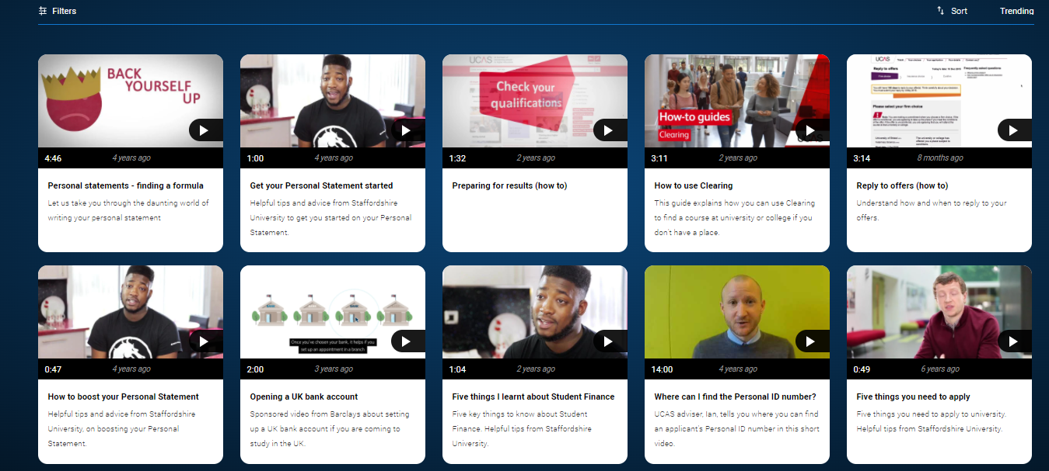
UCAS Videos
https://www.ucas.com/connect/videos
Questions about your application? See
https://www.ucas.com/undergraduate/applying-university/filling-your-ucas-undergraduate-application

Slide 9
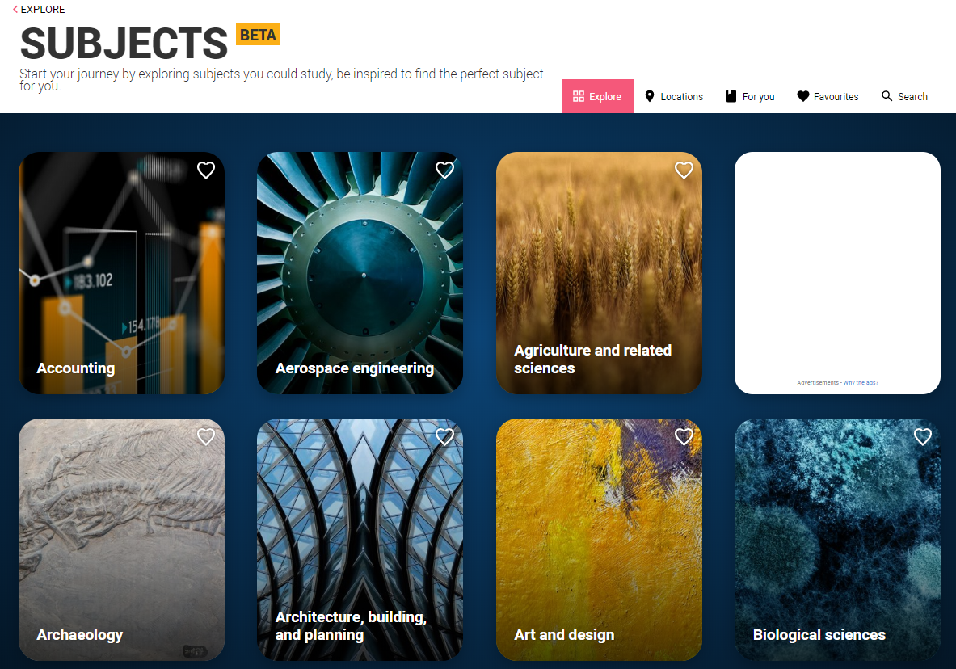
Get some ideas with Subject Guides https://www.ucas.com/explore/subjects

Slide 10
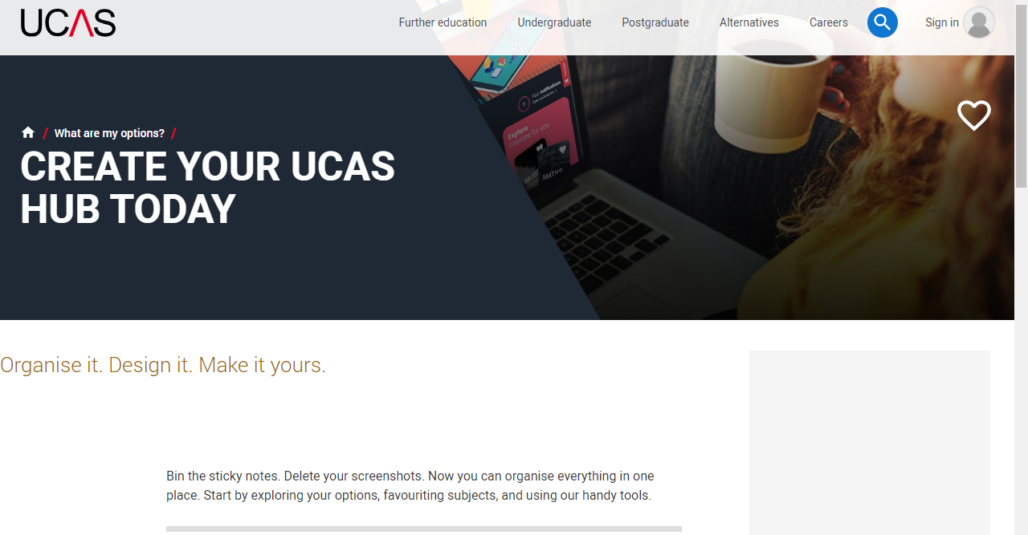
Organise everything UCAS within UCAS Hub https://www.ucas.com/what-are-my-options/create-your-ucas-hub-today

Slide 11
The UCAS Course Search facility is at https://digital.ucas.com/search
Type in the name of a course, subject or area you are interested in
Make sure to select entry year 2023-2024
Make sure to select ‘Undergraduate’

Slide 12
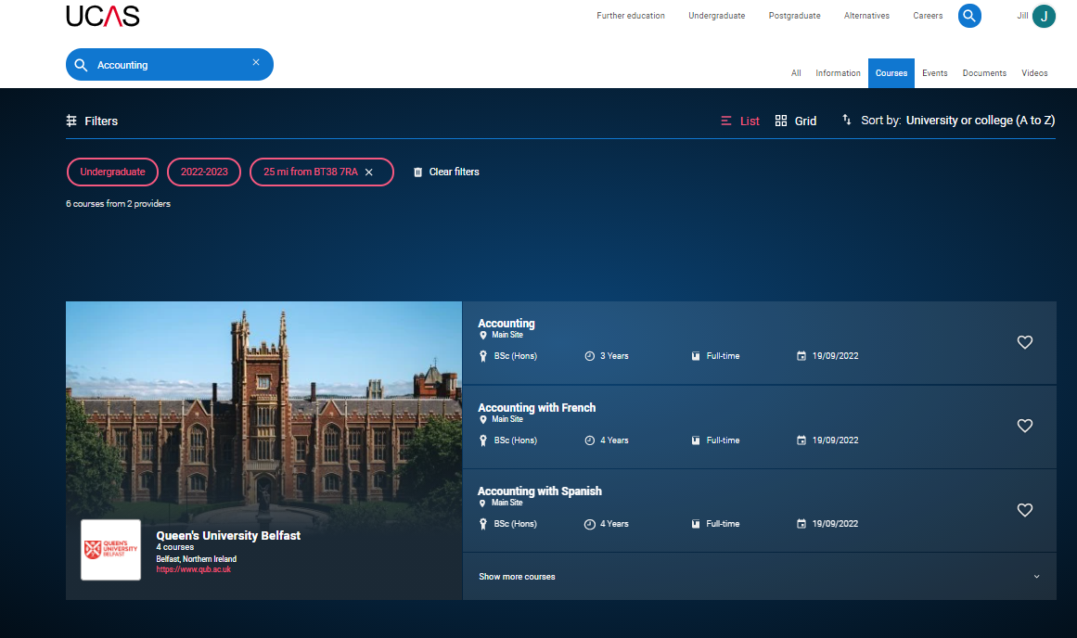
Course search will find courses in your chosen subject throughout the UK, for example, Accounting.
YOU CAN FILTER RESULTS USING THE LEFT HAND SIDE OF THE PAGE

Slide 13
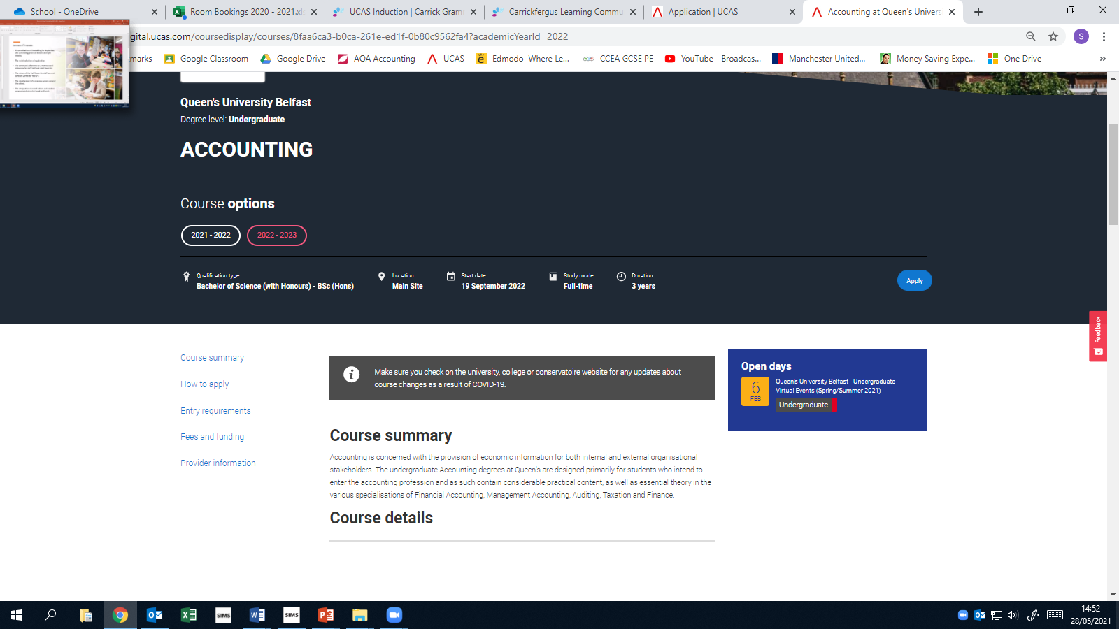
You MUST consult course search information for any courses you intend applying for – note especially the ENTRY REQUIREMENTS and you may be required to do additional entrance tests (your responsibility to register for these EARLY)
Some courses will require evidence in your personal statement that you fit their entry profile

Slide 14
Information we need from you for your reference
Refer to the handout ‘Year 14 UCAS Reference Information – to be returned to Mr Martin by Friday 2nd September’
Note what detail we need from you if we are to write a decent reference for you! (NB staff will be asked to comment on your reliability / adherence to deadlines / attention to detail in your reference….they will use HOW you fill the form in to help them make these comments!)

Slide 15
Some VITAL information regarding INTERNAL DEADLINES! (apart from early applicants)
By your return to school in August
- first sections of UCAS form (aside from choices and personal statement) completed.
- ‘early applicants’ register with Mr Martin (quicker and stricter timescale – Mr Martin will give further details separately)
Friday 2nd September - completed your ‘Yr14: UCAS reference Information’ sheet and handed this in to Mr Martin
Monday 5th September - anyone who needs to take a university admissions test should have given their name to Mr McMorris.
Friday 16th September
- you will know which member of staff is looking after you for your personal statement and application guidance.
- Personal Statement handed in to your UCAS teacher.
(FYI- by this stage, all of your AS teachers will have completed their references on you and handed them over to the UCAS staff, who will begin working on writing your UCAS reference)
Friday 23rd September – Uni choices added to your form and final draft of your personal statement completed, ready for your UCAS interview
29th September – 7th October – UCAS Interview with your designated teacher
YOUR COMPLETION DEADLINE IS FRIDAY 21st October 2022.

